Slide 1
CPSC331 - Spring 2019 Tutorial 10
Khobaib Zaamout

Slide 2
Q1.a: Sketch a proof of correctness
(a) Sketch a proof (not a complete proof) that the addToArray algorithm solves the problem it is supposed to. Your answer should include each of the following:
The claim about addToArray that should be established.
The proof technique that can be used to prove this claim.
Explanation of how to prove what is needed for the basis.
Explanation of how the inductive step is completed. Mention any useful properties of binary search trees and describe how they are used.
Note: You may assume that the “Binary Search Tree Invariant” (given in Lecture #9) is satisfied when any execution of the addToArray method begins.

Slide 3
Q1.a: Sketch a proof of correctness Background
Algorithm:
Binary Search Tree Invariant:
private void addToArray(BSTNode x, ArrayList<E> A) {
1. if (x != null) {
2. addToArray(x.left, A);
3. A.add(x.element);
4. addToArray(x.right, A);
}
}
This is a binary tree whose nodes each store distinct values belonging to a set E that has a total order. The finite set represented is the set of values stored at nodes.
If this binary search tree is not empty then every value stored in the left subtree of the root is less than the value stored at the root, and every value stored in the right subtree is greater than the value stored at the root.
If this binary search tree is not empty then the left and right subtrees are also binary search trees (so that, in particular, they and their subtrees also satisfy this “Binary Search Tree Invariant”).

Slide 4
Q1.a: Sketch a proof of correctness Background
Proof outline:
A recursive algorithm is correct if:
Basis
Inductive Step:
Inductive Hypothesis
Inductive Claim
Proof Steps
Proof Closure
If precondition is satisfied and algorithm is executed, then:
eventually the execution ends, and
postcondition is satisfied

Slide 5
Q1.a: Sketch a proof of correctness Proof sketch
Proof sketch:
Question requires at least:
The claim about addToArray that should be established.
The proof technique that can be used to prove this claim.
Explanation of how to proved what is needed for the basis.
Explanation of how the inductive step is completed. Mention any useful properties of binary search trees and describe how they are used.

Slide 6
Q1.a: Sketch a proof of correctness Proof sketch
Proof sketch:
Question requires at least:
Claim: If the “Binary Search Tree” invariant is satisfied, and the addToArray algorithm is executed with
a node x in this binary search tree, and
an ArrayList A, storing values with the same type as are stored in this binary search tree,
Then:
the execution of this algorithm eventually halts, and
all the elements stored in the subtree with root x have been added to A, in increasing order.
The claim about addToArray that should be established.
The proof technique that can be used to prove this claim.
Explanation of how to proved what is needed for the basis.
Explanation of how the inductive step is completed. Mention any useful properties of binary search trees and describe how they are used.

Slide 7
Q1.a: Sketch a proof of correctness Proof sketch
Proof sketch:
Question requires at least:
The claim about addToArray that should be established.
The proof technique that can be used to prove this claim.
Explanation of how to proved what is needed for the basis.
Explanation of how the inductive step is completed. Mention any useful properties of binary search trees and describe how they are used.

Slide 8
Q1.a: Sketch a proof of correctness Proof sketch
Proof sketch:
Question requires at least:
This claim can be proved by mathematical induction.
One can use induction on either the size or depth of the subtree with root x.
We will use induction on the size
In either case, the strong form of mathematical induction should be used.
The claim about addToArray that should be established.
The proof technique that can be used to prove this claim.
Explanation of how to proved what is needed for the basis.
Explanation of how the inductive step is completed. Mention any useful properties of binary search trees and describe how they are used.

Slide 9
Q1.a: Sketch a proof of correctness Proof sketch
Proof sketch:
Question requires at least:
The claim about addToArray that should be established.
The proof technique that can be used to prove this claim.
Explanation of how to proved what is needed for the basis.
Explanation of how the inductive step is completed. Mention any useful properties of binary search trees and describe how they are used.

Slide 10
Q1.a: Sketch a proof of correctness Proof sketch
Proof sketch:
Question requires at least:
Basis: we consider the case that the subtree with root x has size 0
i.e. node x is null
In this case, the subtree with root x is the empty tree and the ArrayList A should not be changed.
Then by inspection of the code, the test at line 1 fails and the execution ends immediately after that without any changes.
The claim about addToArray that should be established.
The proof technique that can be used to prove this claim.
Explanation of how to proved what is needed for the basis.
Explanation of how the inductive step is completed. Mention any useful properties of binary search trees and describe how they are used.

Slide 11
Q1.a: Sketch a proof of correctness Proof sketch
Proof sketch:
Question requires at least:
The claim about addToArray that should be established.
The proof technique that can be used to prove this claim.
Explanation of how to proved what is needed for the basis.
Explanation of how the inductive step is completed. Mention any useful properties of binary search trees and describe how they are used.

Slide 12
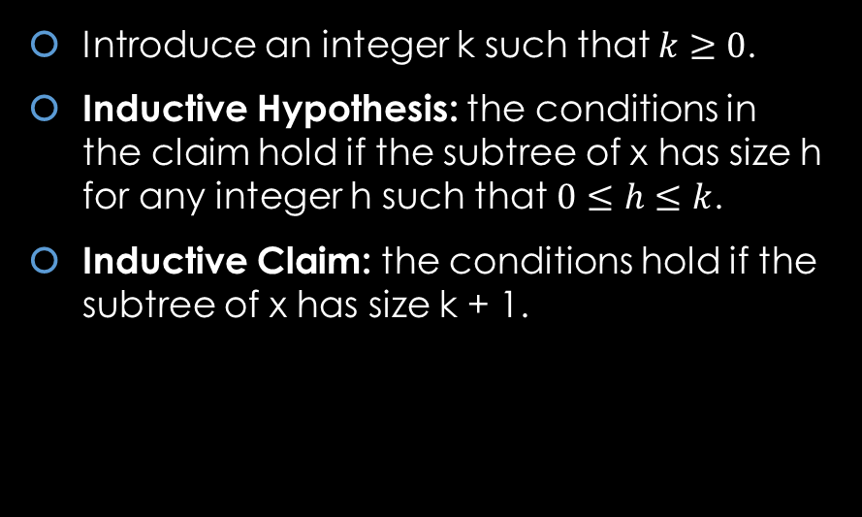
Q1.a: Sketch a proof of correctness Proof sketch
Proof sketch:
Question requires at least:
Introduce an integer k such that $k≥0$.
Inductive Hypothesis: the conditions in the claim hold if the subtree of x has size h for any integer h such that $0≤h≤k$.
Inductive Claim: the conditions hold if the subtree of x has size k + 1.
The claim about addToArray that should be established.
The proof technique that can be used to prove this claim.
Explanation of how to proved what is needed for the basis.
Explanation of how the inductive step is completed. Mention any useful properties of binary search trees and describe how they are used.

Slide 13
Q1.a: Sketch a proof of correctness Proof sketch
Proof sketch:
Question requires at least:
The claim about addToArray that should be established.
The proof technique that can be used to prove this claim.
Explanation of how to proved what is needed for the basis.
Explanation of how the inductive step is completed. Mention any useful properties of binary search trees and describe how they are used.
Proof

Slide 14
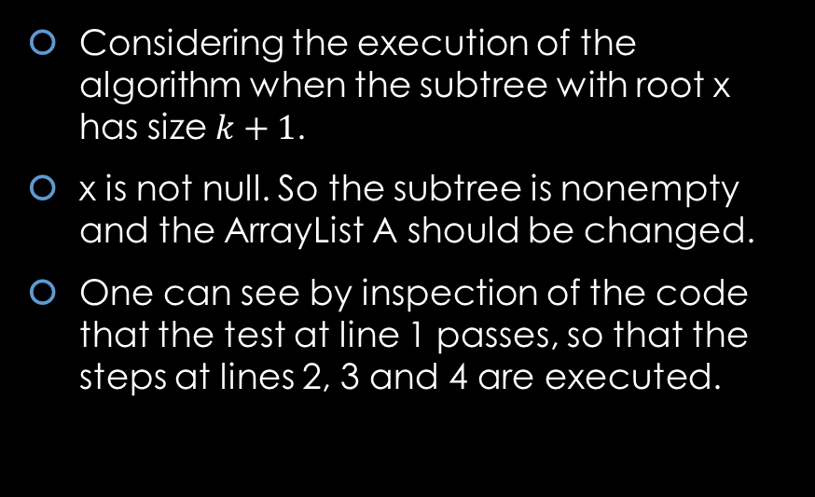
Q1.a: Sketch a proof of correctness Proof sketch
Proof sketch:
Question requires at least:
Considering the execution of the algorithm when the subtree with root x has size $k+1$.
x is not null. So the subtree is nonempty and the ArrayList A should be changed.
One can see by inspection of the code that the test at line 1 passes, so that the steps at lines 2, 3 and 4 are executed.
The claim about addToArray that should be established.
The proof technique that can be used to prove this claim.
Explanation of how to proved what is needed for the basis.
Explanation of how the inductive step is completed. Mention any useful properties of binary search trees and describe how they are used.
Proof

Slide 15
Q1.a: Sketch a proof of correctness Proof sketch
Proof sketch:
Question requires at least:
It follows by the Binary Search Tree Invariant Property #3 that the subtree with root x is also a binary search tree
It also follows that Property #2: All of the nodes in the left subtree of the subtree with root x store values that are less than the value stored at x, and all the nodes of the right subtree of the subtree with root x store values that are greater than x.
The claim about addToArray that should be established.
The proof technique that can be used to prove this claim.
Explanation of how to proved what is needed for the basis.
Explanation of how the inductive step is completed. Mention any useful properties of binary search trees and describe how they are used.
Proof

Slide 16
Q1.a: Sketch a proof of correctness Proof sketch
Proof sketch:
Question requires at least:
It follows that all the elements stored in the subtree with root x have been added in increasing order if they have been added as follows:
a) First, all the elements stored in the left subtree were added, in increasing order.
b) Then, the element stored at the root (that is, at x) was added.
c) Finally, all the elements stored in the right subtree were added in increasing order.
The claim about addToArray that should be established.
The proof technique that can be used to prove this claim.
Explanation of how to proved what is needed for the basis.
Explanation of how the inductive step is completed. Mention any useful properties of binary search trees and describe how they are used.
Proof

Slide 17

Q1.b: prove that $T(n)≤5n + 1$ Background
Proof sketch:
Question requires at least:
Note that the left and right subtrees of the subtree with root of x both have sizes that are strictly less than the size of the subtree with root x.
Therefore, It follows by the IH that the execution of the step at line 2 eventually ends, and all the elements stored in the left subtree have been added to A: Part (a) carried out.
By inspecting the code the execution of the step at line 3 also eventually ends, and the element stored at x has been added to A: Part (b) carried out.
It also follows by the IH that the execution of the step at line 4 eventually ends, and all the elements stored in the right subtree have been added to A: Part (c) carried out.
The computation now ends, and all the elements stored in the subtree with root x have been added to A as needed to complete the Inductive Step and complete the proof. □
The claim about addToArray that should be established.
The proof technique that can be used to prove this claim.
Explanation of how to proved what is needed for the basis.
Explanation of how the inductive step is completed. Mention any useful properties of binary search trees and describe how they are used.
Proof

Slide 18
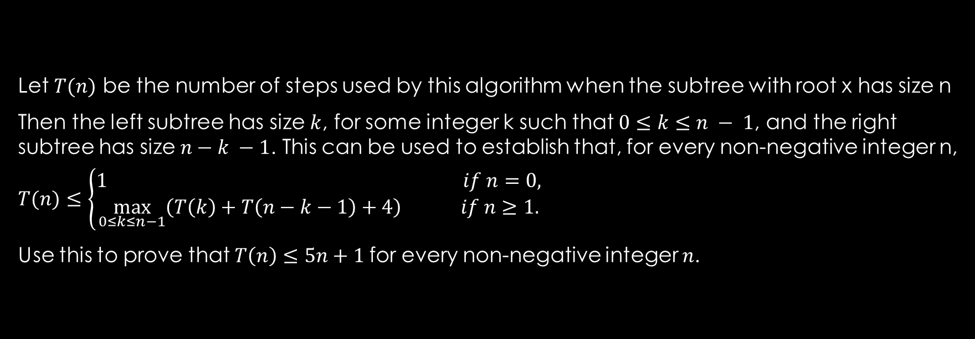

Q1.b: prove that $T(n)≤5n + 1$
Let $T(n)$ be the number of steps used by this algorithm when the subtree with root x has size n
Then the left subtree has size $k$, for some integer k such that $0≤k≤n − 1$, and the right subtree has size $n−k −1$. This can be used to establish that, for every non-negative integer n,
$$T(n)≤\left\{\begin{aligned}1 if n=0, \\ \max_{0≤k≤n−1}\left(T\left(k\right)+T\left(n−k−1\right)+4\right) if n≥1.\end{aligned}\right.$$
Use this to prove that $T\left(n\right)≤5n+1$for every non-negative integer $n$.

Slide 19
Q1.b: prove that 𝑇(𝑛) ≤ 5𝑛 + 1 Background
Algorithm:
Proof outline:
private void addToArray(BSTNode x, ArrayList<E> A) {
1. if (x != null) {
2. addToArray(x.left, A);
3. A.add(x.element);
4. addToArray(x.right, A);
}
}
Basis
Inductive Step:
Inductive Hypothesis
Inductive Claim
Proof Steps
Proof Closure

Slide 20
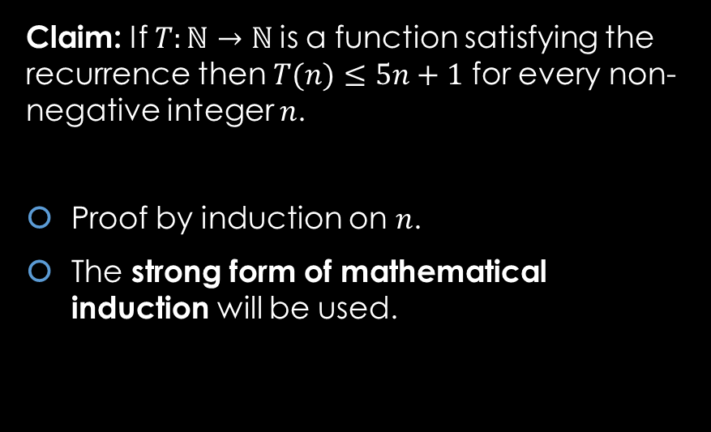
Q1.b: prove that $T(n)≤5n + 1$
Proof:
Proof outline:
Claim: If $T:ℕ→ℕ$is a function satisfying the recurrence then $T(n)≤5n+1$ for every non-negative integer $n$.
Proof by induction on $n$.
The strong form of mathematical induction will be used.
Basis
Inductive Step:
Inductive Hypothesis
Inductive Claim
Proof Steps
Proof Closure

Slide 21
Q1.b: prove that $T(n)≤5n + 1$
Proof:
Proof outline:
Basis
Inductive Step:
Inductive Hypothesis
Inductive Claim
Proof Steps
Proof Closure

Slide 22
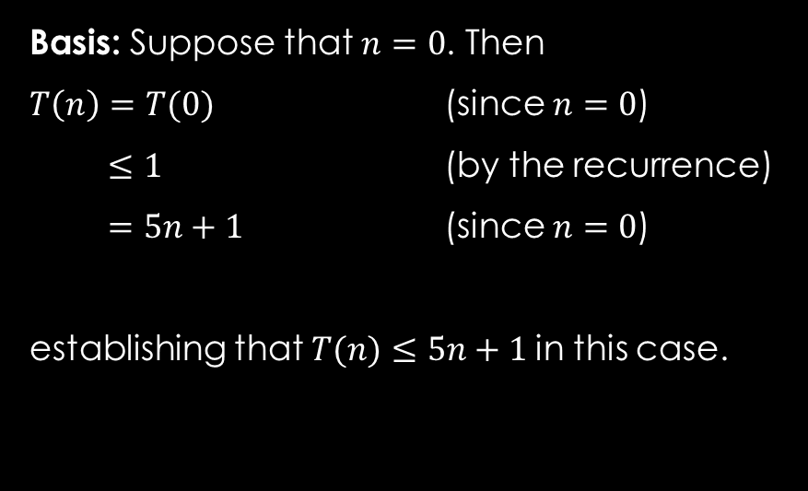
Q1.b: prove that $T(n)≤5n + 1$
Proof:
Proof outline:
Basis: Suppose that $n=0$. Then
$T\left(n\right)=T(0)$ (since $n=0$)
$≤1$ (by the recurrence)
$=5n+1$ (since $n=0$)
establishing that $T(n)≤5n+1$in this case.
Basis
Inductive Step:
Inductive Hypothesis
Inductive Claim
Proof Steps
Proof Closure

Slide 23
Q1.b: prove that $T(n)≤5n + 1$
Proof:
Proof outline:
Basis
Inductive Step:
Inductive Hypothesis
Inductive Claim
Proof Steps
Proof Closure

Slide 24
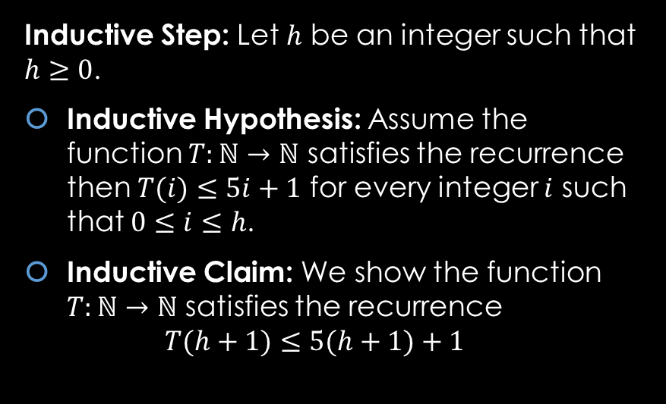
Q1.b: prove that $T(n)≤5n + 1$
Proof:
Proof outline:
Inductive Step: Let $h$ be an integer such that $h≥0$.
Inductive Hypothesis: Assume the function $T:ℕ→ℕ$ satisfies the recurrence then $T(i)≤5i+1$ for every integer $i$ such that $0≤i≤h$.
Inductive Claim: We show the function $T:ℕ→ℕ$ satisfies the recurrence $T(h+1)≤5(h+1)+1$
Basis
Inductive Step:
Inductive Hypothesis
Inductive Claim
Proof Steps
Proof Closure

Slide 25
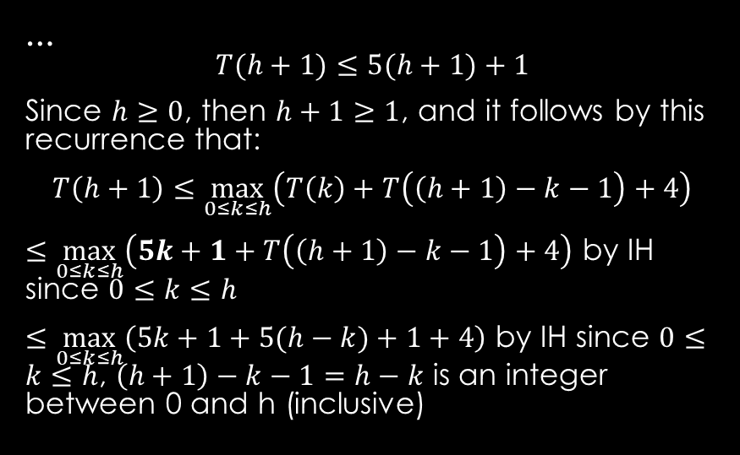
Q1.b: prove that $T(n)≤5n + 1$
Proof:
Proof outline:
… $$T(h+1)≤5(h+1)+1$$
Since $h≥0$, then $h+1≥1$, and it follows by this recurrence that:
$$T\left(h+1\right)≤\max_{0≤k≤h}\left(T\left(k\right)+T\left(\left(h+1\right)−k−1\right)+4\right)$$
$≤\max_{0≤k≤h}\left(5k+1+T\left(\left(h+1\right)−k−1\right)+4\right)$ by IH since $0≤k≤h$
$≤\max_{0≤k≤h}\left(5k+1+5(h−k)+1+4\right)$ by IH since $0≤k≤h$, $\left(h+1\right)−k−1=h−k$ is an integer between 0 and h (inclusive)
Basis
Inductive Step:
Inductive Hypothesis
Inductive Claim
Proof Steps
Proof Closure

Slide 26
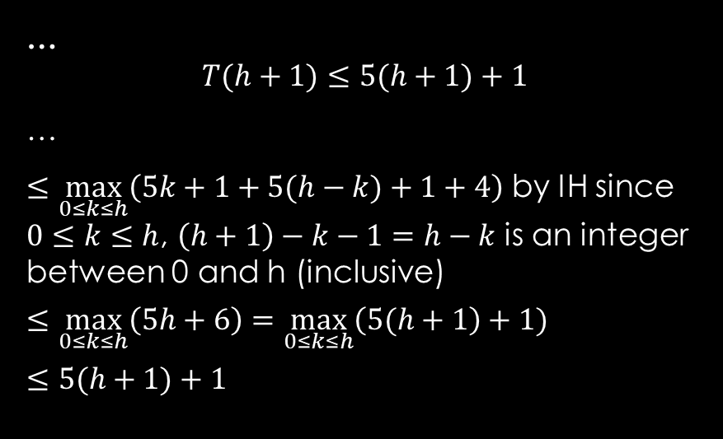
Q1.b: prove that $T(n)≤5n + 1$
Proof:
Proof outline:
… $$T(h+1)≤5(h+1)+1$$
…
$≤\max_{0≤k≤h}\left(5k+1+5(h−k)+1+4\right)$ by IH since $0≤k≤h$, $\left(h+1\right)−k−1=h−k$ is an integer between 0 and h (inclusive)
$$≤\max_{0≤k≤h}\left(5h+6\right)=\max_{0≤k≤h}\left(5(h+1\right)+1)$$
$$≤5(h+1)+1$$
Basis
Inductive Step:
Inductive Hypothesis
Inductive Claim
Proof Steps
Proof Closure

Slide 27
Q1.b: prove that $T(n)≤5n + 1$
Proof:
Proof outline:
as required to establish the Inductive Claim and complete the proof. □
Basis
Inductive Step:
Inductive Hypothesis
Inductive Claim
Proof Steps
Proof Closure

